Slide 2
QIX Engine 101
Engine API and Generic Objects
Alexander Karlsson

Slide 3
Disclaimer

Slide 5
What we’ll cover
Architectural Overview
The Agnostic Engine API
Generic Objects
Internals of a QVF
How to piss off a sales guy

Slide 6
Architectural Overview
Clients that are capable of running websockets
Proxy Service
Engine API
Engine API
QRS API
QIX Engine
Repository Server
QRS API

Slide 7
Architectural Overview
Mashup API
Extension API
Qlik Sense Client
Engine API
QIX Engine

Slide 8


Slide 9

The Agnostic Engine API
A JavaScript Object Notation Remote Procedure Call style protocol
Or just JSON RPC for short
Protocol, not a language
qsocks - a javascript implementation
Sensei – super secret…
The building block for all of our clients, APIs and some server components such as the Migration Service and Data Prep
Commonly used client side but can also run server side.

Slide 10
The Agnostic Engine API
Diplomatic Pulse
SenseIt
Service Charges
https://github.com/pouc/qlik-elastic

Slide 11

The Agnostic Engine API
Request
Response
{
"method": "CreateObject",
"handle": 1,
"id": 10,
"params":[{
"qMetaDef": {
"title":"My new sheet", "description": “Poopie”
},
"qInfo": {
"qId":"HvZvHV",
"qType":"sheet“
}
}],
"jsonrpc": "2.0"
}
{
"id": 10,
"result": {
"qReturn": {
"qType": "GenericObject",
"qHandle": 4
},
"qInfo": {
"qId": "HvZvHV",
"qType": "sheet“
}
},
"change": [1,2,4],
"jsonrpc": "2.0"
}

Slide 13
Demo

Slide 14
Generic Objects
A Generic Object is truly generic
Everything is a generic object (almost)
A generic object can have different types, some that our client knows how to render or others which could be user defined.
A generic object is hierarchal by nature, a generic object with the type sheet contains it’s children i.e. the charts and list boxes.
A generic object can have dynamic properties which the engine recognizes, prefixed with q
Full dynamic properties, the engine does not care but persists them to the app.

Slide 15
Generic Objects
Client
1. Connect
Engine
2. Connection successful
4. App is serialized and loaded into memory
3. Send OpenApp on global handle (-1)
6. Client creates a new object in the client
8. New GenericObject has been created.
Qvf
5. App handle returned to client
7. Client sends object via CreateObject on app handle
9. Engine sends back handle for GenericObject
11. App with the new changes is saved to disk.
10. Client sends DoSave to save the changes to the app.

Slide 16
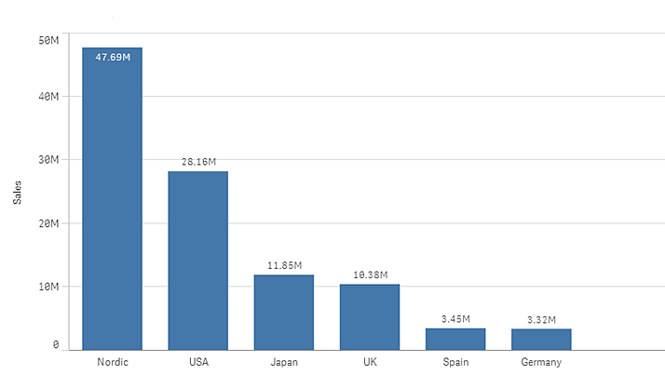
Generic Objects
Engine
Client
Generic Object
Generic Object

Slide 17
Demo

Slide 18
How to piss off a sales guy

